Slide 1

DATA ANALYSIS POWERBI CAPSTONE PROJECT
Sales Analysis for Year 2018

Slide 2


CONTENTS
01
INTRODUCTION
02
DATA SOURCES
03
DASHBOARD & KEY ANALYSIS
03
CONCLUSION

Slide 3

Introduction
An extensive summary of the sales performance for 2018 is given by this dashboard.
It draws attention to important data including overall sales, profit, sales dispersion by area and category, and consumer purchasing trends.
Finding trends, important drivers, and useful insights to enhance company results is the aim.

Slide 4
Data Sources
The information comes from the business's 2018 sales transactions.
Product categories, subcategories, states, payment methods, and customer names are important dimensions.
Total sales, profit, order count, and client spending are among the metrics that are examined.

Slide 5
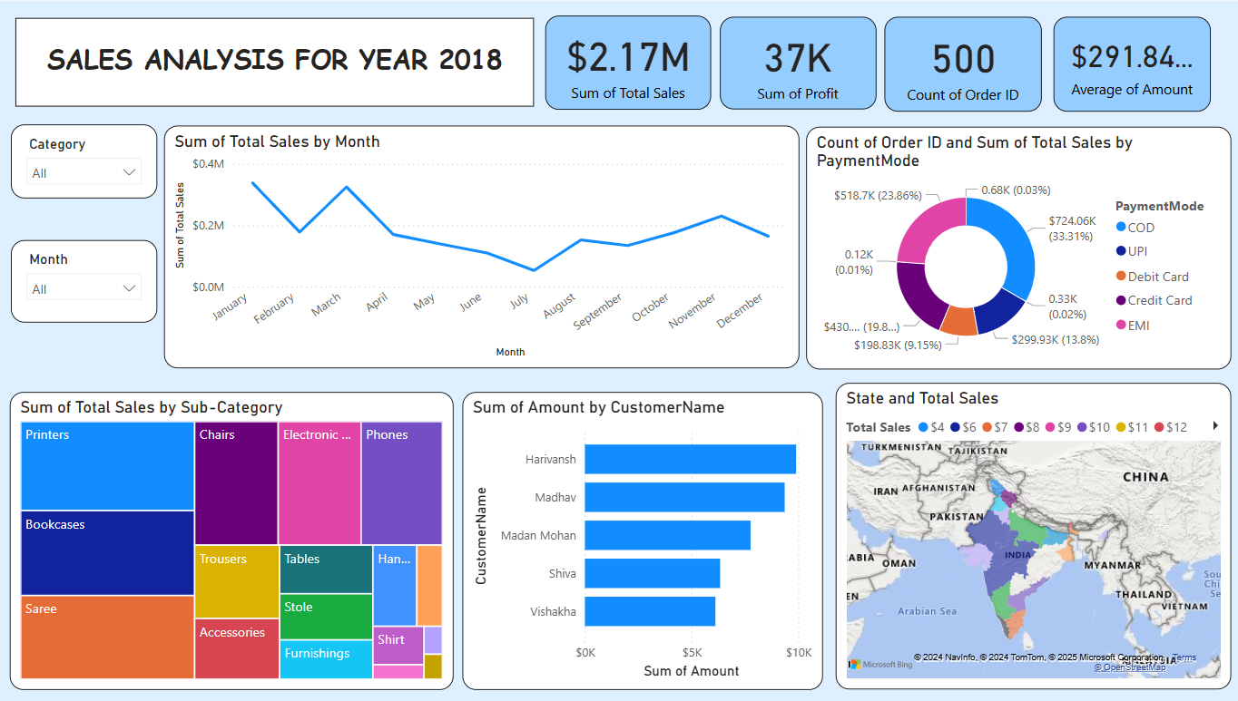
Dashboard

Slide 6
Key Analysis
Total Performance
2018 total sales: $2.17 million.
$291.84 is the average transaction amount.
Q4 saw the highest sales, suggesting a seasonal tendency.
Sales by Category and Subcategory
Two of the best-performing subcategories are chairs and phones.
Sarees and printers also make a substantial contribution to the volume of sales , chance to improve underperforming subcategories, such as bookcases.
Monthly Sales
As the year draws to a close, sales gradually rise and reach their highest points in November and December.
Promotional initiatives have the potential to increase revenue during off-season months.
Consumer Perspectives
Revenue is largely driven by high-spending clients like Vishakha, Madhav, and Harivansh.
Targeted marketing techniques may improve consumer spending and retention even further.
Analysis of Payment Modes
The most popular payment options are COD and credit card.
The use of UPI and debit cards suggests areas for increasing the uptake of digital payments.
Distribution of Regional Sales
State-by-state sales distribution analysis shows that several important states have performed well.
Making strategic investments in underperforming areas could increase market share overall.

Slide 7
Conclusions
Actionable possibilities to improve customer interaction, refine sales techniques, and strengthen weak categories are highlighted in this report.
Targeted efforts and routine monitoring can promote long-term company growth.

